Slide 1
Getting Through the Post-Covid Period in the Airbnb NYC Business

Slide 2
Agenda
Objective
Background
Key Findings
Recommendations
Appendix:
Data sources
Data methodology
Data model assumptions

Slide 3
Objective
Improve our strategy for reviving the business after COVID.
Understand critical insights from the Airbnb NYC business before COVID.
Estimate customer travel preferences for the post-COVID period.

Slide 4
Background
Because of travel limitations caused by the COVID-19 epidemic.
Airbnb revenue fell the most in NYC in the second quarter of 2020.
Now that the travel restrictions have been eased, the company should be run to recover the damage.

Slide 5
Key Findings
Because of the high cost, acquiring premium homes should not be emphasized right now.
As the number of nights to stay increases, so does the price, and bookings automatically decrease.
It has been found that hosts offering short-term stays have received the most bookings in the past.

Slide 6
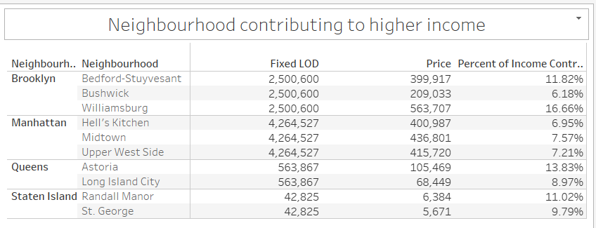
Popular Accommodations across NYC Areas
The following are popular areas in each Neighborhood group that contribute to higher income, hence these places should be targeted more for revenue creation.
Manhattan-Midtown
Brooklyn-Williamsburg
Queens-Astoria
Staten Island-Randall Manor

Slide 7
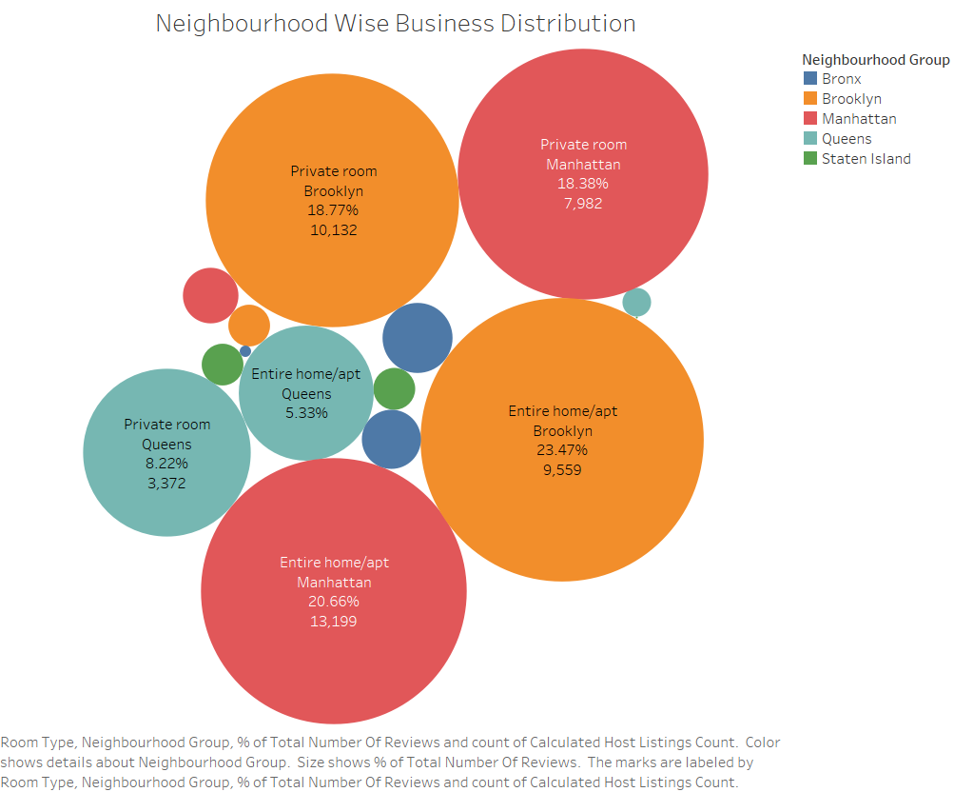
Top 10 Hosts By Reviews
Private rooms and entire homes/apartments should be targeted in Brooklyn and Manhattan because they appear to be popular.
Shared Rooms should be targeted because the prices are already low, and a sensible approach will bring in more clients.
Property in Manhattan and Brooklyn is the most costly of any area.

Slide 8
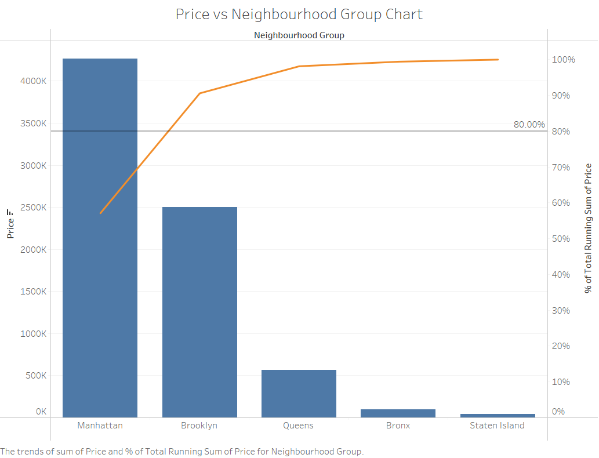
Price insights based on Neighbourhood Group
Focus on boosting listings in Queens, Bronx, and Staten Island to improve revenue.
Manhattan produces 90% of revenue.
Because Manhattan is at the top of the list and is extremely popular, hosts can lower the price to entice clients.

Slide 9
Recommendations
Increase the number of hosts in the Staten Islands. And boost the number of low/medium-rent hosts in Manhattan.
Increase the number of host postings for Entire home/apt and Private rooms, as these are popular.
Invest more in providing monthly rentals at NYC properties.

Slide 10
APPENDIX – DATA SOURCES
Here's a look at our data dictionary. Host information such as Id, name, host name, and host id. Property Listings information such as latitude, longitude, price, and room type.
The following data sources were used by the team: Data given by the Upgrade Team Airbnb listings data from NYC Survey done in 2019

Slide 11
APPENDIX – DATA METHODOLOGY
The Airbnb dataset was thoroughly examined by us. Cleaning the dataset by addressing missing values was part of the process.
In Tableau, create new calculated fields 'Min Nights Binned' and 'No. reviews Per Listing’ in Tableau.
Creating visualizations with the Tableau tool to help you comprehend significant findings from the analysis.

Slide 12
APPENDIX – Data Model Assumptions
We assumed the data before to the COVID - 19 era was reaching the required income.
We assumed the company does not wish to expand to new territories in NYC just yet.
The company's strategies are determined with the assumption that travel will increase in the post COVID time.

